Slide 1
Centralised Digital Platform for Comprehensive student activity record in Higher Education Institutions (HEIs)
CSE7302 - Capstone Project
Review-1
Batch Number: CSE_151
Under the Supervision of,
Guide: Ms. Riya Sanjesh
(Computer Science and Engineering)
Presidency University
Roll Number | Student Name
20221CSE0005 | Kothareddy Vamshidhar Reddy
20221CSE0044 | Abhiram PB
20221CSE0276 | Akanksha Bhartiya
Name of the Program: CSE 7101 Capstone Project (Semester VIII)
Name of the HoD: Dr. Asif Mohammed , Dr. Blessed Prince
Name of the Program Project Coordinator: Dr. Jayavadivel Ravi, Mr. Muthuraju V
Name of the School Project Coordinators: Dr. Sampath A K , Dr. Geetha A

Slide 2
Problem Statement Number: SIH25093
Organization: Government of Jammu and Kashmir
Category (Hardware / Software / Both) : Software
Problem Description:
There is currently no unified digital system that allows Higher Education Institutions to systematically capture, verify, track, and present a student’s complete academic and non-academic record throughout their academic tenure. Students lack a credible, verified digital profile that can support placements, higher education admissions, scholarships, and skill recognition. Faculty and administrators face additional workload due to repetitive documentation, manual validation, and report generation.

Slide 3
Content
Problem Statement
Objectives
Background and Related work for title Selection
Analysis of Problem Statement
Innovation or Novel Contributions
Git-hub Link
Timeline of the Project
References

Slide 4
Problem Statement
Higher Education Institutions (HEIs) currently store student academic and non-academic records across multiple systems, departments, and paper files. Important data such as workshops, certifications, internships, competitions, club activities, and community service is not maintained in a single verified system.
Because of this:
Students do not have a complete digital profile
Faculty and administrators spend extra time on manual verification
Institutions face difficulties during NAAC, AICTE, and NIRF reporting
There is a strong need for a centralized, secure, and verified digital platform that maintains the complete student lifecycle from admission to graduation.

Slide 5
Objectives
Digitize and centralize academic and co-curricular student records
Create a verified student profile from the time of admission
Reduce dependency on paper-based documentation
Enable faculty to monitor and mentor students effectively
Support fast and accurate accreditation reporting
Prepare students with verified profiles for placements and higher studies

Slide 6
Background and Related Work
This project lies in the Educational Technology (EdTech) domain, focusing on managing student academic and co-curricular records in Higher Education Institutions.
Existing systems such as ERP and LMS handle marks, attendance, and learning content, but they do not capture a student’s full development. Records related to internships, certifications, events, clubs, and community service are usually stored in separate tools or physical files.
Research Gap
There is no unified platform that connects academic and non-academic records with faculty verification and portfolio generation. This gap limits transparency, student visibility, and institutional efficiency.
Title Justification
The title “Smart Student Hub” reflects a centralized system that connects students, faculty, and administrators for complete and verified student record management.

Slide 7
Analysis of Problem Statement (contd...)
Existing Solutions
Most institutions depend on:
ERP systems for marks and attendance
LMS platforms for course delivery
Manual records or isolated tools for co-curricular and extra-curricular activities
These systems work in isolation and do not provide a unified or verified view of a student’s overall development.
Limitations Identified
Academic and non-academic records are not linked
Absence of a centralized student profile
Lack of faculty validation reduces record reliability
Manual data compilation for NAAC, AICTE, and NIRF reporting
Students lack a credible portfolio for placements and higher studies

Slide 8
Analysis of Problem Statement (contd...)
Software Requirements:
IDE: Visual Studio Code
Runtime Environment: Node.js (v18.x or later)
Frontend: Next.js (TypeScript), Tailwind CSS
Backend: MongoDB Server / MongoDB Atlas (Cloud)
Email Service: Brevo API
Authentication: JWT (HttpOnly cookies), bcrypt
API Testing: Postman
Design & Prototyping: Figma
Version Control: Git/Github
Hardware Requirements:
No specialized hardware is required. A standard developer laptop with at least 8GB RAM and an internet connection is sufficient for development and deployment.

Slide 9
Analysis of Problem Statement
Smart Student Hub addresses these gaps by offering a centralized, verified, and role-based platform that manages the full student lifecycle.
The chosen technology stack directly supports this goal:
Next.js (TypeScript, Tailwind CSS) enables a fast, responsive dashboard for students and faculty
MongoDB / MongoDB Atlas allows flexible storage of diverse academic and activity records
JWT-based authentication with HttpOnly cookies and bcrypt ensures secure access and data integrity
Brevo Email API supports secure onboarding and record-related notifications
Postman and Git/GitHub support reliable development and collaboration
Figma enables clear UI design for usability across users
Existing solutions store data in silos, whereas Smart Student Hub integrates, verifies, and presents student achievements in a single platform. By using a modern, scalable, and secure technology stack, the system reduces administrative effort, improves transparency, and prepares students with verified profiles for academic and professional growth.

Slide 10
Innovation or Novel Contributions
Unified Student Profile System Introduces a single digital profile that combines academic performance with co-curricular and extra-curricular achievements across the entire student lifecycle.
Faculty-Verified Activity Records Adds a structured faculty/admin approval workflow to validate student-submitted activities, improving data credibility and trust.
Auto-Generated Digital Portfolios Enables students to generate verified portfolios in PDF or shareable link format for placements, scholarships, and higher studies.
Accreditation-Ready Analytics Provides institution-level analytics and structured reports tailored for NAAC, AICTE, and NIRF requirements, reducing manual reporting effort.
Role-Based, Secure Access Model Implements role-specific dashboards (Student, Faculty, Admin) with secure authentication to protect sensitive academic data.
Flexible and Scalable Architecture Designed using modern web technologies to support easy integration with existing ERP, LMS, and digital university platforms.

Slide 11
Github Link
The Github link provided should have public access permission.
Github Link
https://github.com/akanksha0322/CapstoneProject_CSE_151_SmartStudentHub

Slide 12
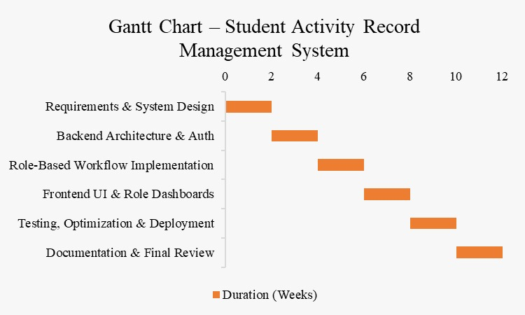
Timeline of the Project (Gantt Chart)

Slide 13
References (IEEE Paper format)
[1] S. R. Kumbhar and P. R. Patil, “Development of Student Performance Tracking Apps,” International Journal of Innovative Research in Science, Engineering and Technology, 2020. Available: https://www.researchgate.net/publication/338342446_Development_of_Student_Performance_Tracking_Apps
[2] M. Alqahtani, “Student’s Digital Portfolio for Assessing and Presenting Talents,” International Journal of Emerging Technologies in Learning (iJET), 2020. Available:https://www.researchgate.net/publication/347529504_Student%27s_Digital_Portfolio_for_Assessing_and_Presenting_Talents
[3] M. González-Calatayud, J. Prendes-Espinosa, and P. Roig-Vila, “The Contribution of Digital Portfolios to Higher Education Students’ Autonomy and Digital Competence,” Education Sciences, vol. 13, no. 8, p. 829, Aug. 2023, doi: 10.3390/educsci13080829. Available: https://www.researchgate.net/publication/373127588_The_Contribution_of_Digital_Portfolios_to_Higher_Education_Students%27_Autonomy_and_Digital_Competence
[4] J. L. D. Silva, R. L. Santos, and A. P. Costa, “Mixed-Method Study of Utilizing Portfolios to Document and Assess Co-Curricular Activities: Student and Advisor Perceptions,” Journal of Educational Technology Systems, 2019. Available: https://www.researchgate.net/publication/338048191_Mixed-Method_Study_of_Utilizing_Portfolios_to_Document_and_Assess_Co-Curricular_Activities_Student_and_Advisor_Perceptions
[5] A. Sharma and R. Verma, “Review on Student Activities Monitoring System,” International Journal for Research in Applied Science & Engineering Technology (IJRASET), 2024. Available: https://www.researchgate.net/publication/389430770_Review_on_Student_Activities_Monitoring_System

Slide 14


